Slide 1
ENGINEERING CLINICS
PROJECT PRESENTATION
TEAM NUMBER : 2
PROJECT TITLE :
INQUIRE HUB
A ONE DAY TRAVEL ITINERARY WEB APPLICATION

Slide 2
TEAM MEMBERS
TEAM NUMBER : 2
MURALI KRISHNAN.P 18BCS001
THANUMALYEN.K 18BCS002
MANJU.S 18BCS007
MRIDULA.C.S 18BCS008
SANJAY RAM.V 18BCS031
SHALINI.R 18BCS091

Slide 3

DESCRIPTION
This web application makes your travel experience
easy and efficient in Coimbatore. Though other
applications gives enough information ,this app
focuses only on local specialities that still remain
unveiled and undiscovered.
FRONTEND : Using HTML 5,CSS 3 and JavaScript
BACKEND : Using PHP and MySQL

Slide 4
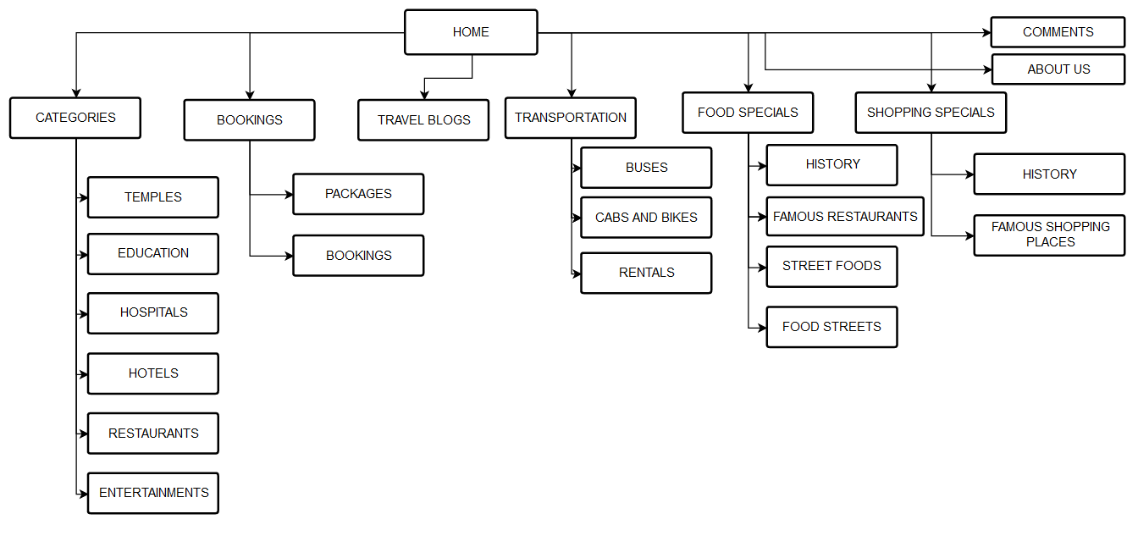
WORFLOW DIAGRAM

Slide 5

PROTOTYPE
TOOL USED : JUSTINMIND PROTOTYPER

Slide 6
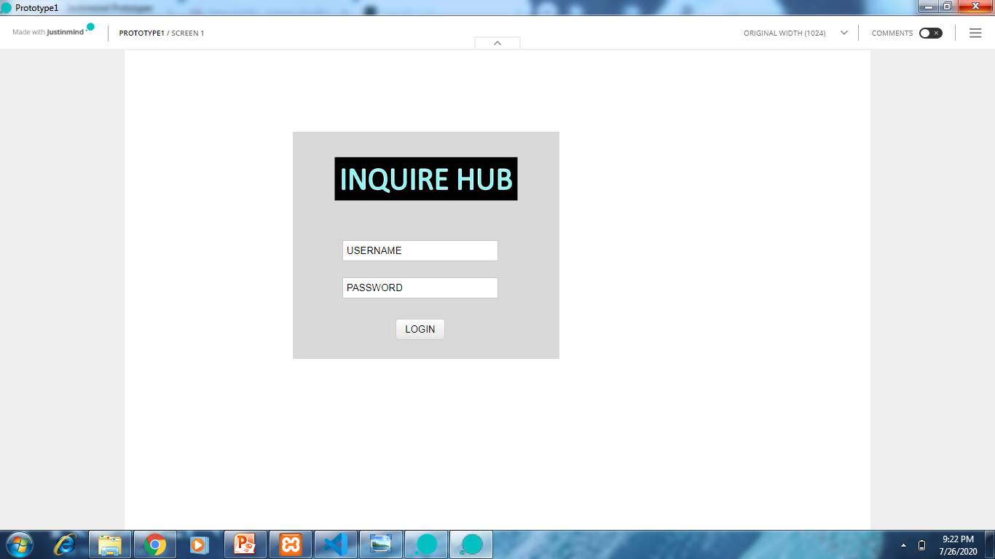
PROTOTYPE
LOGIN PAGE

Slide 7
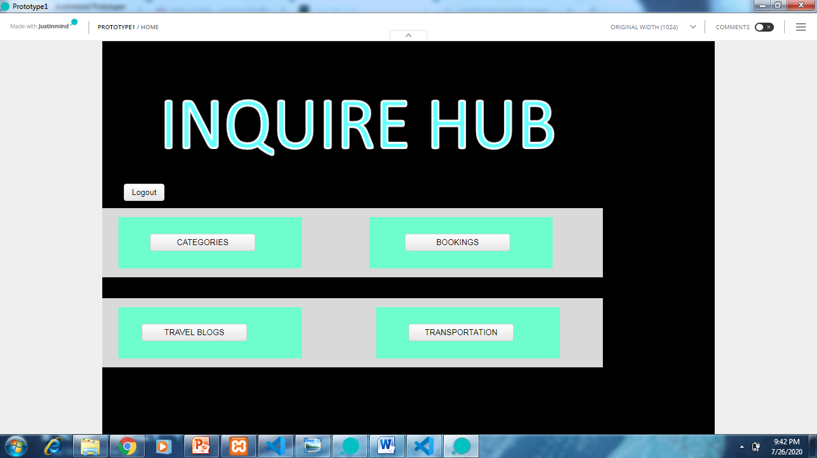
PROTOTYPE
HOME PAGE

Slide 8
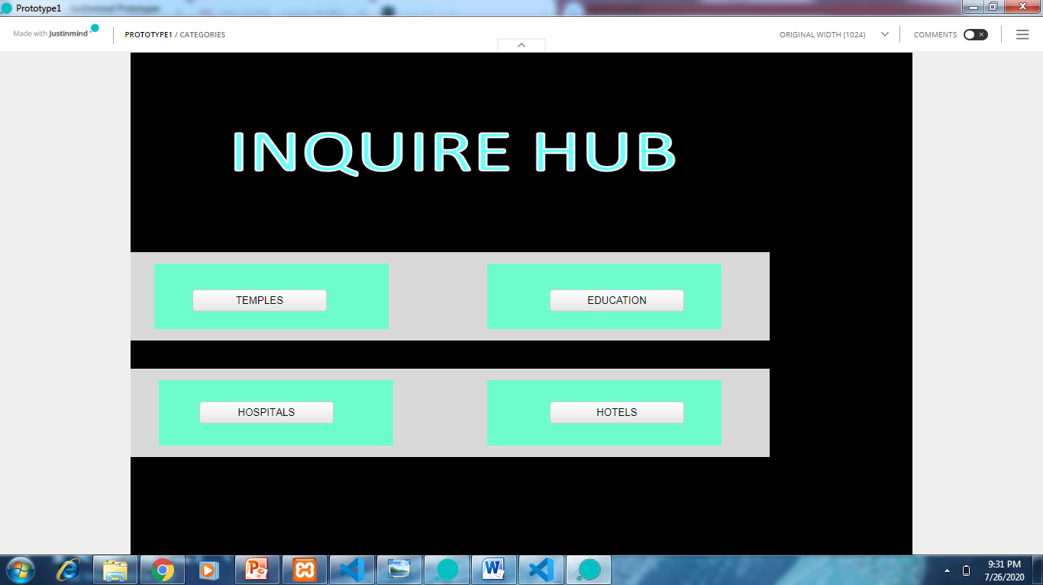
PROTOTYPE
CATEGORIES PAGE

Slide 9
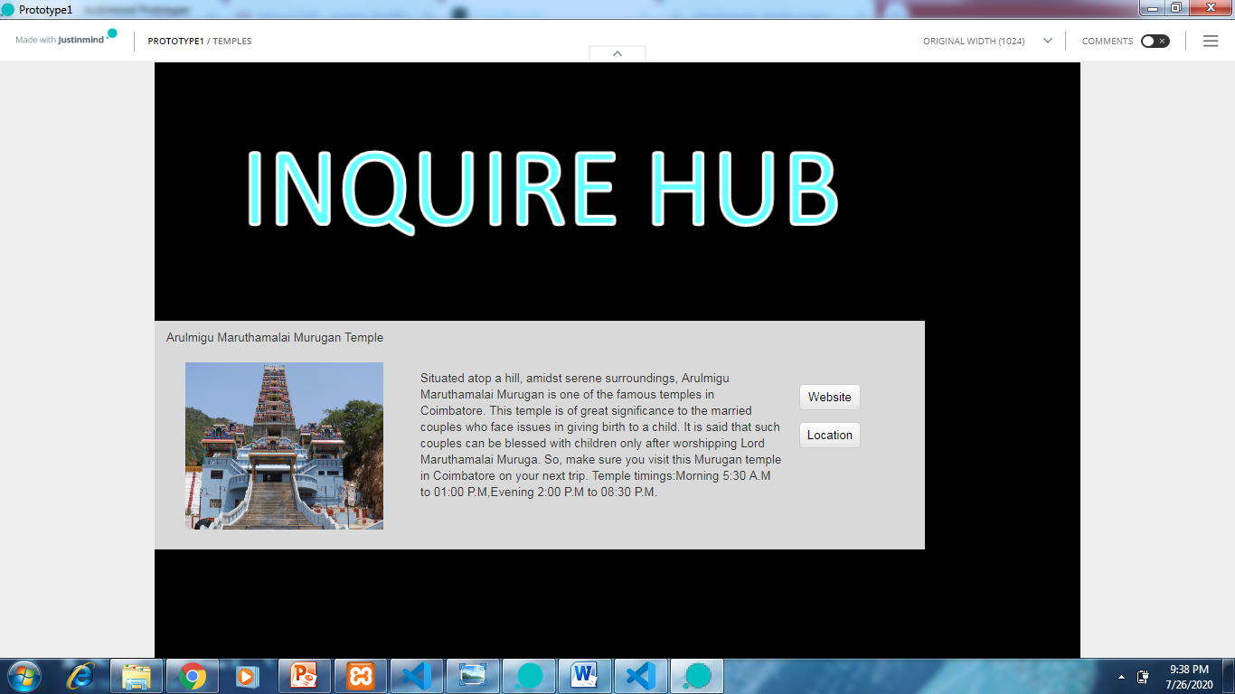
PROTOTYPE
TEMPLES PAGE

Slide 10
PROTOTYPE
HOME PAGE

Slide 11
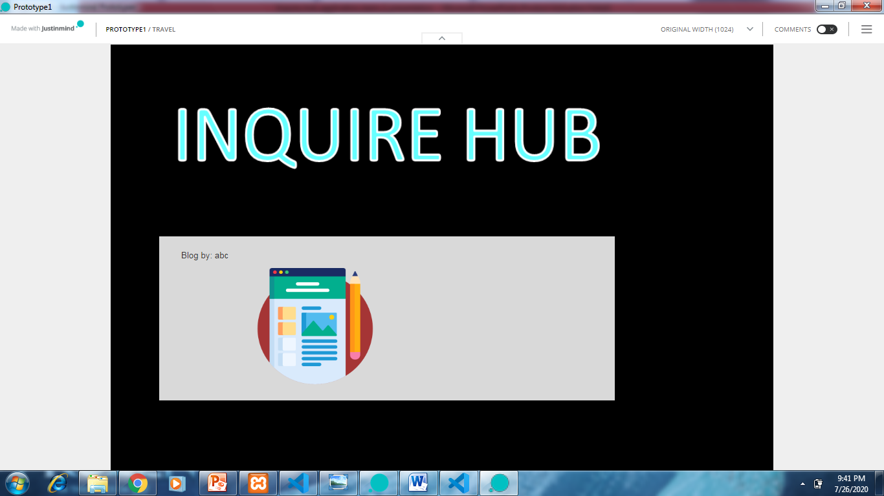
PROTOTYPE
BLOGS PAGE

Slide 12
PROTOTYPE
HOME PAGE

Slide 13
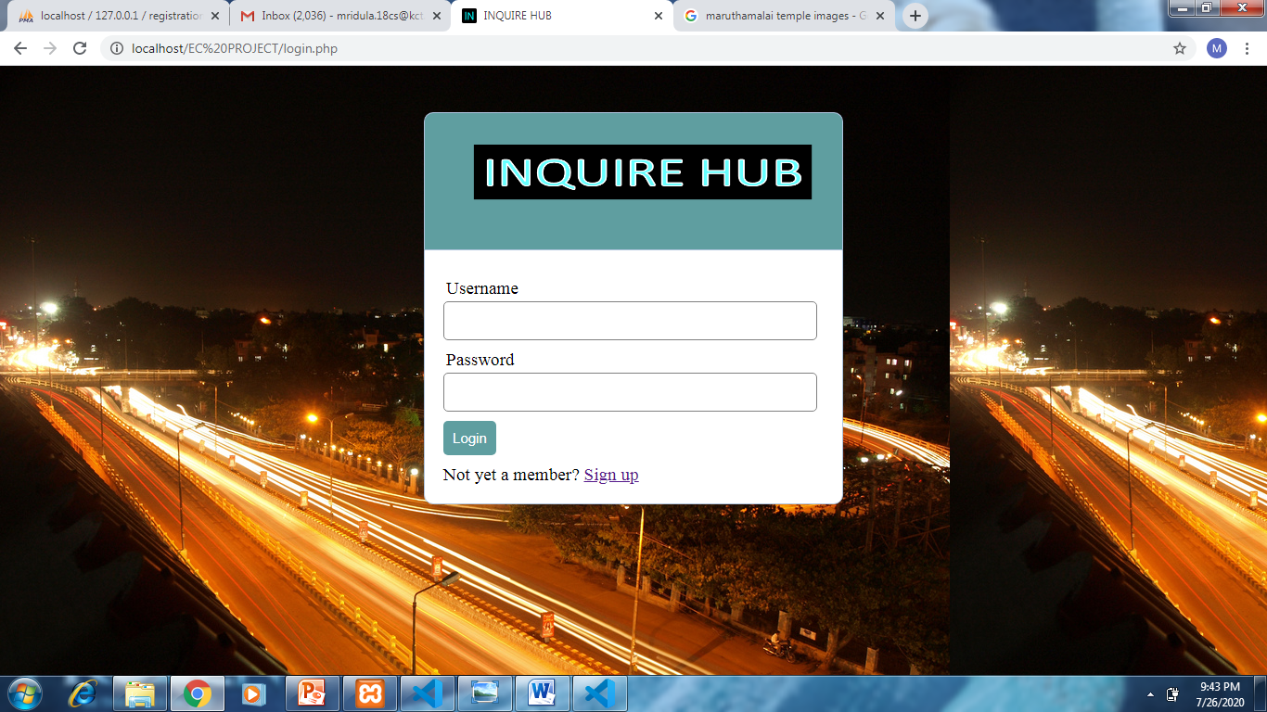
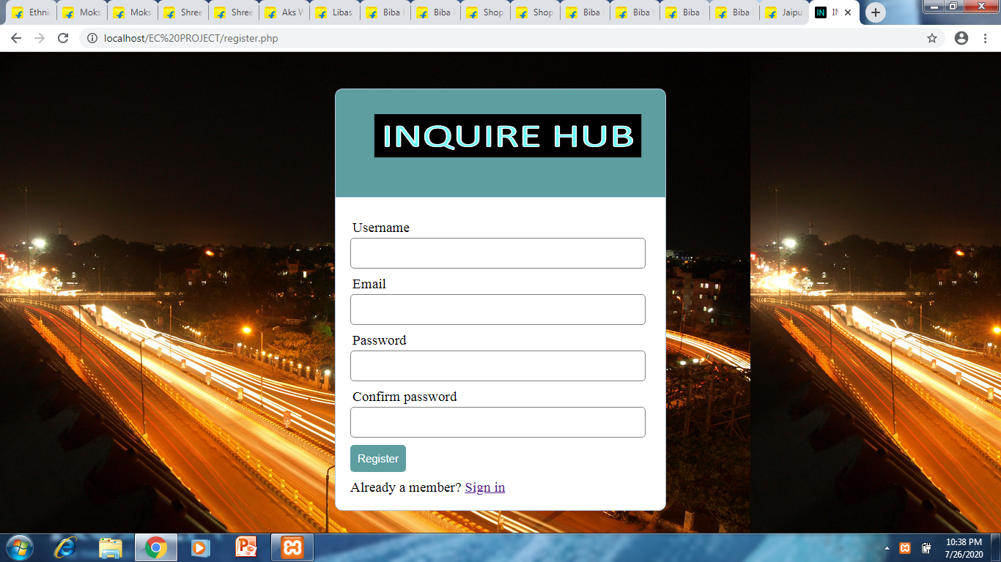
SCREEN SHOTS OF THE WEBSITE
LOGIN PAGE
SIGN UP PAGE

Slide 14
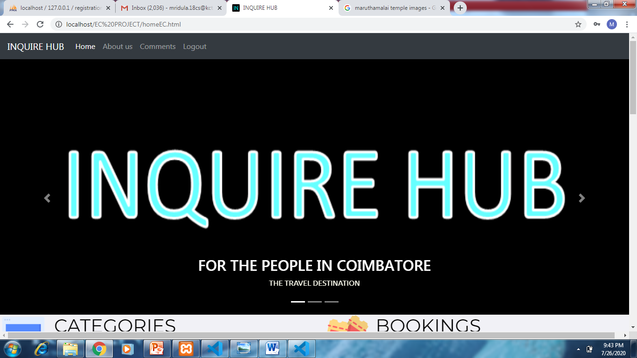
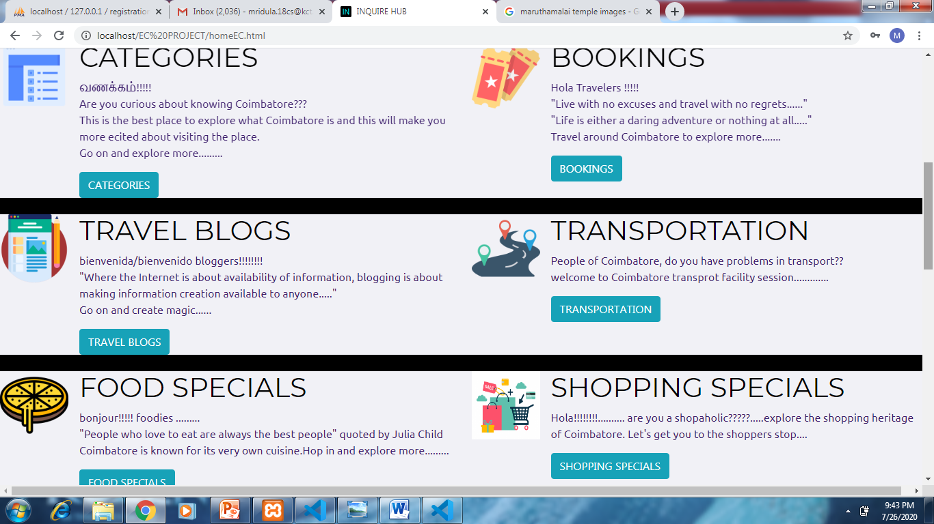
SCREEN SHOTS OF THE WEBSITE
HOME PAGE

Slide 15
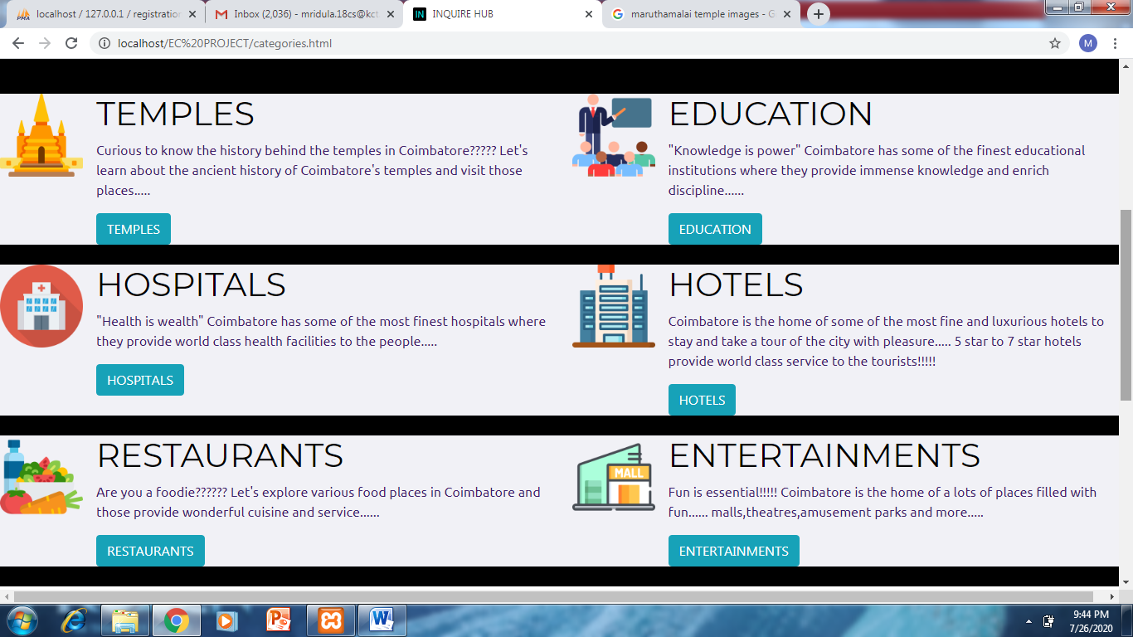
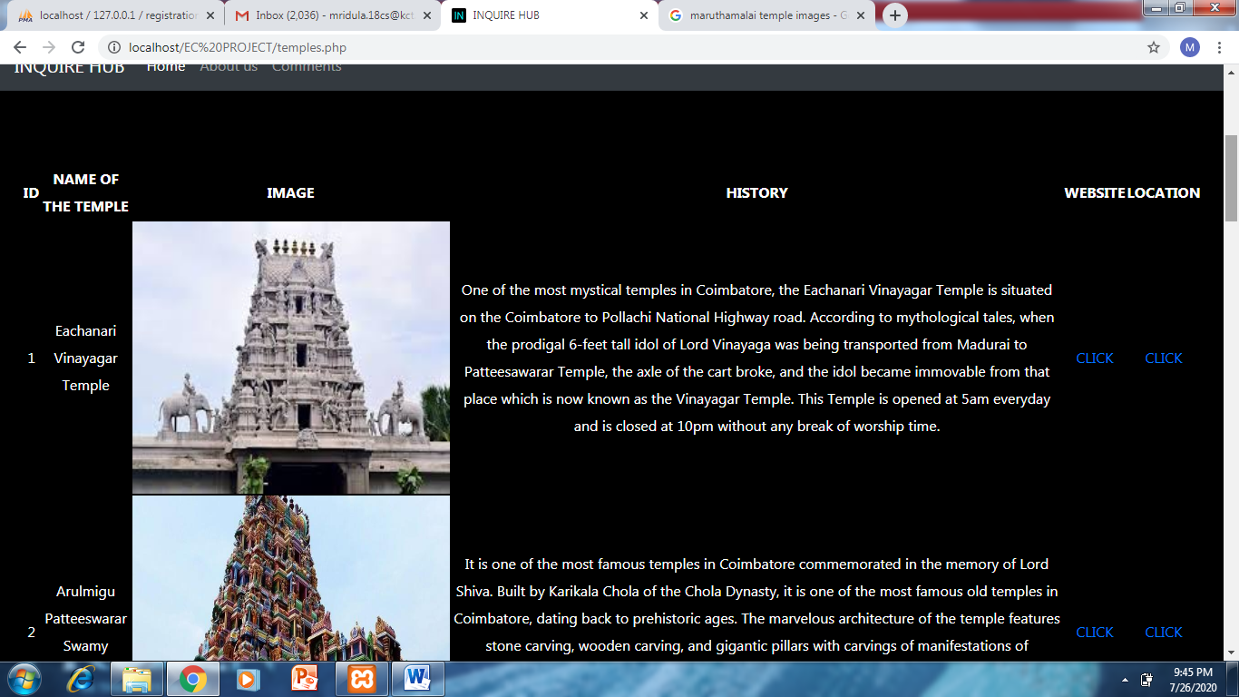
SCREEN SHOTS OF THE WEBSITE
CATEGORIES PAGE
TEMPLES PAGE

Slide 16
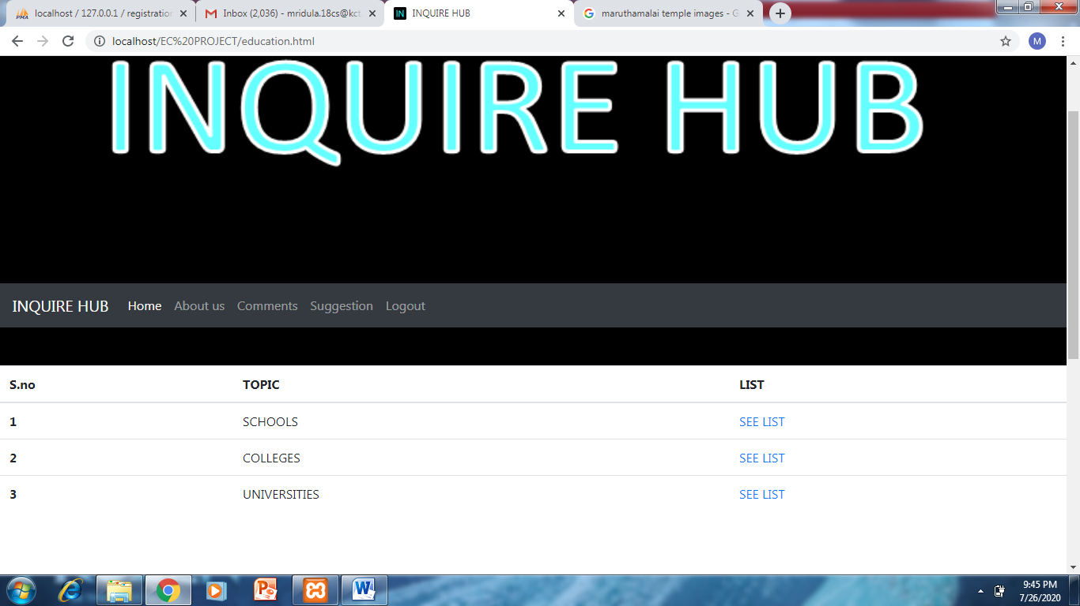
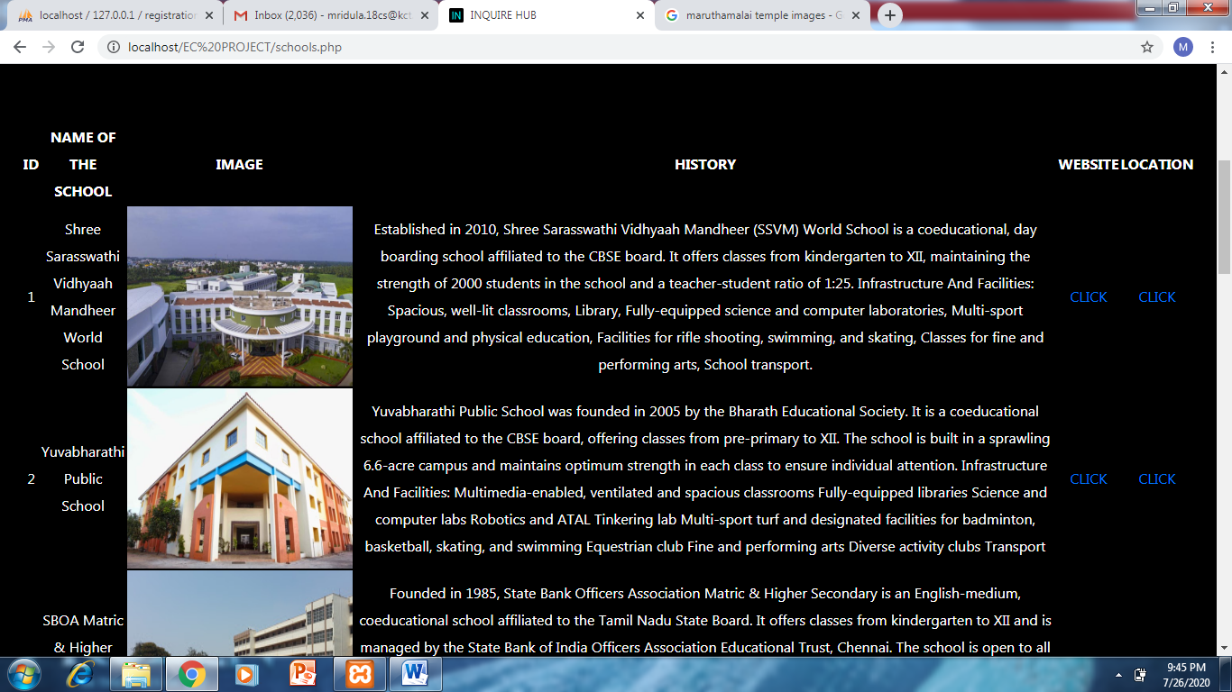
SCREEN SHOTS OF THE WEBSITE
EDUCATION PAGE
SCHOOLS PAGE

Slide 17
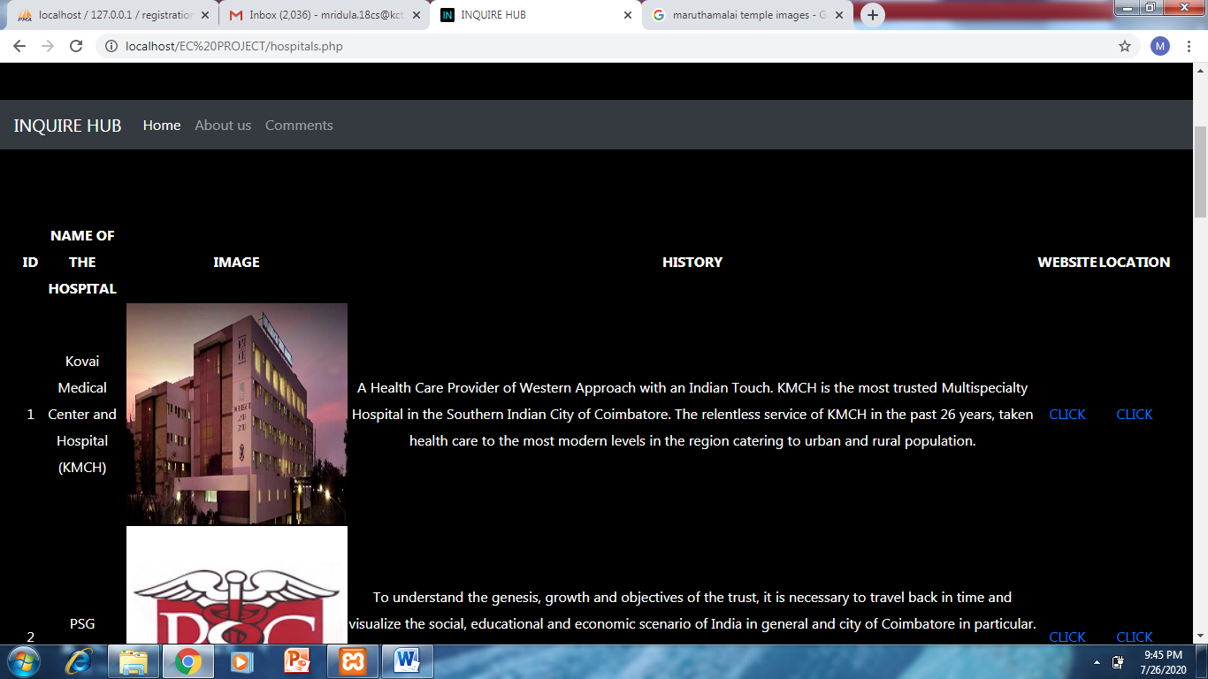
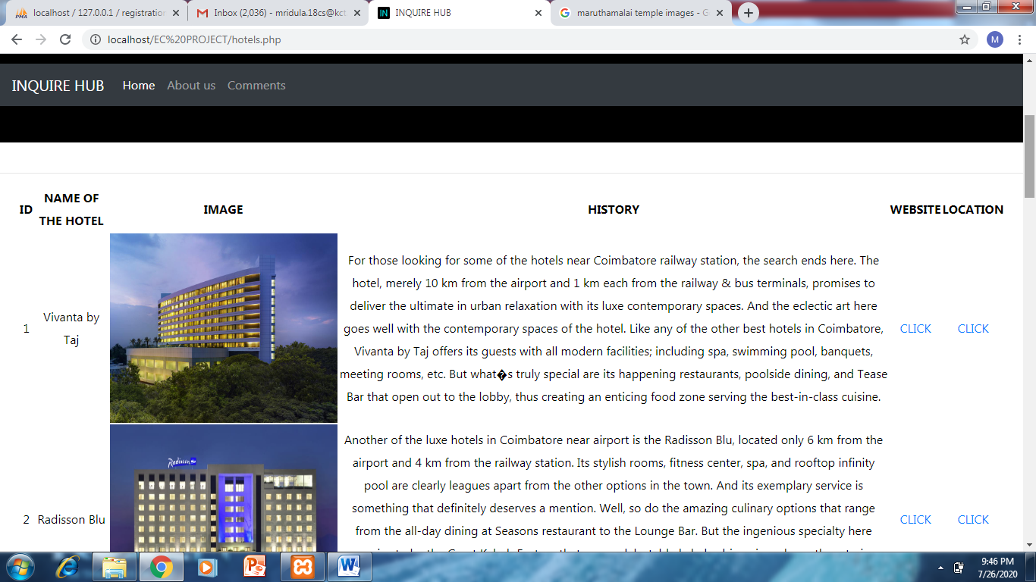
SCREEN SHOTS OF THE WEBSITE
HOSPITALS PAGE
HOTELS PAGE

Slide 18
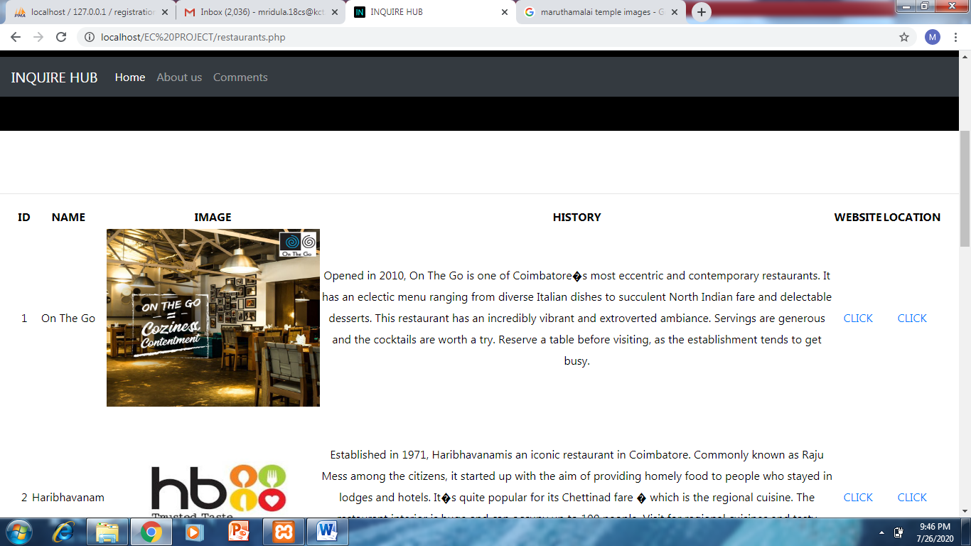
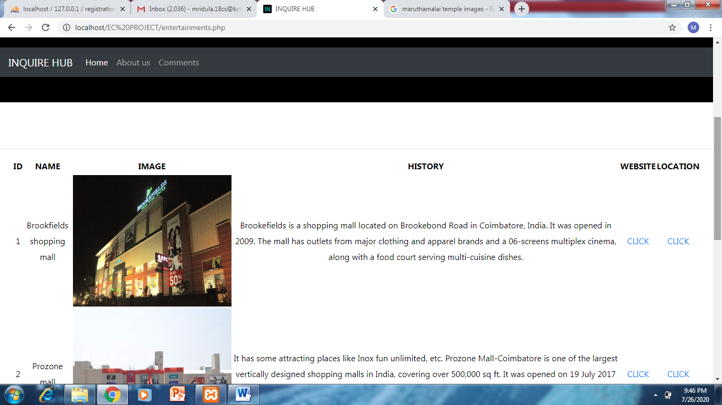
SCREEN SHOTS OF THE WEBSITE
RESTAURANTS PAGE
ENTERTAINMENTS PAGE

Slide 19
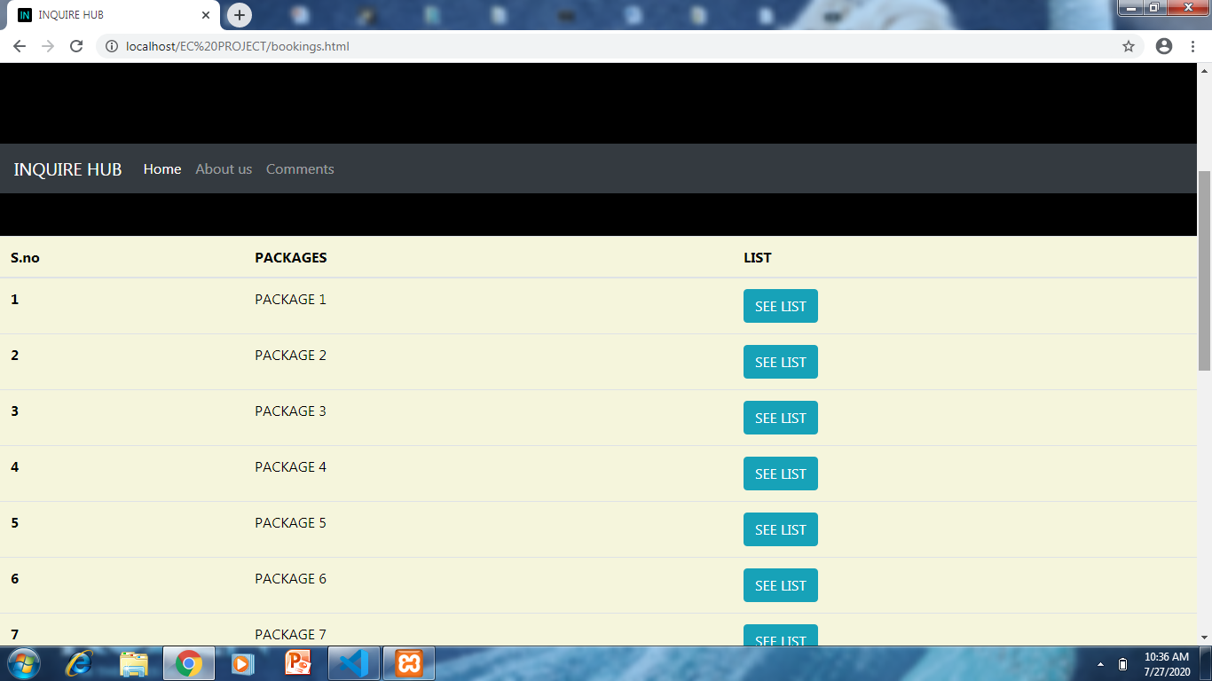
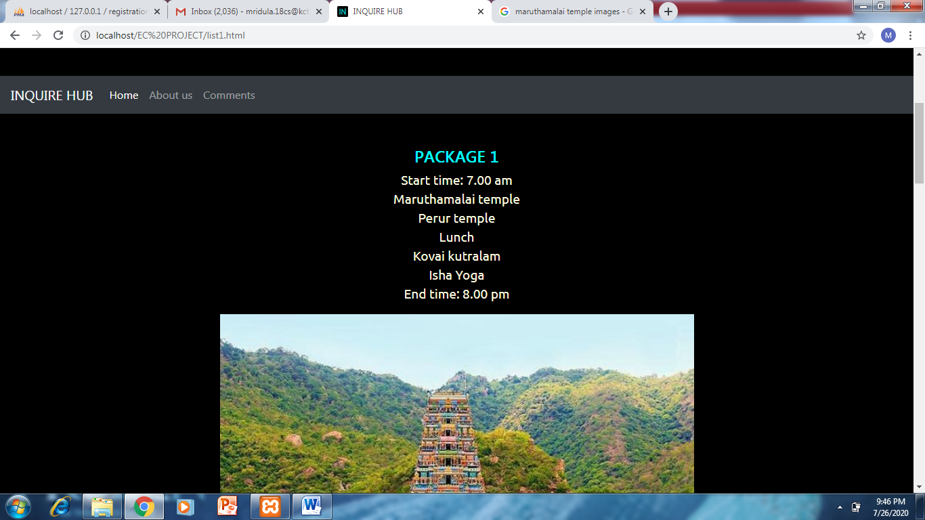
SCREEN SHOTS OF THE WEBSITE
BOOKINGS PAGE
PACKAGE 1 PAGE

Slide 20
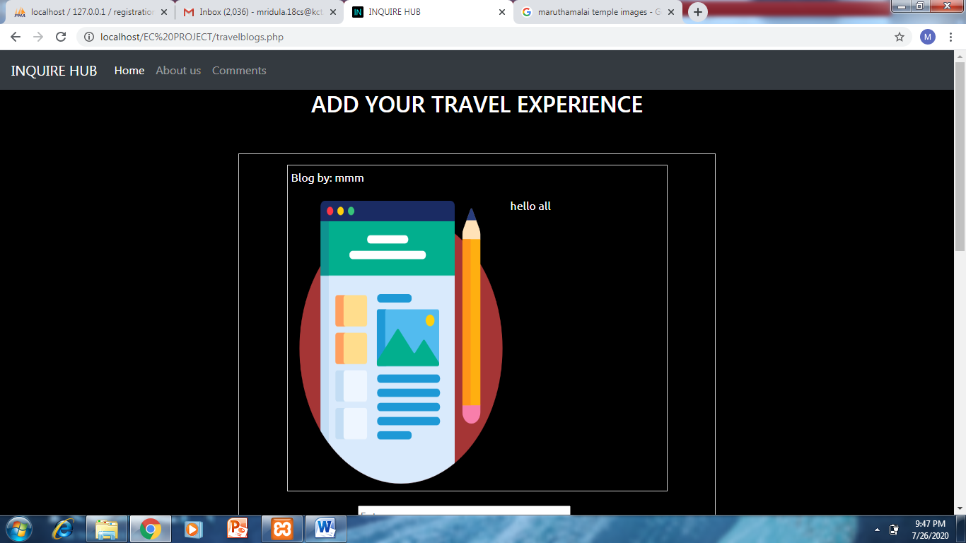
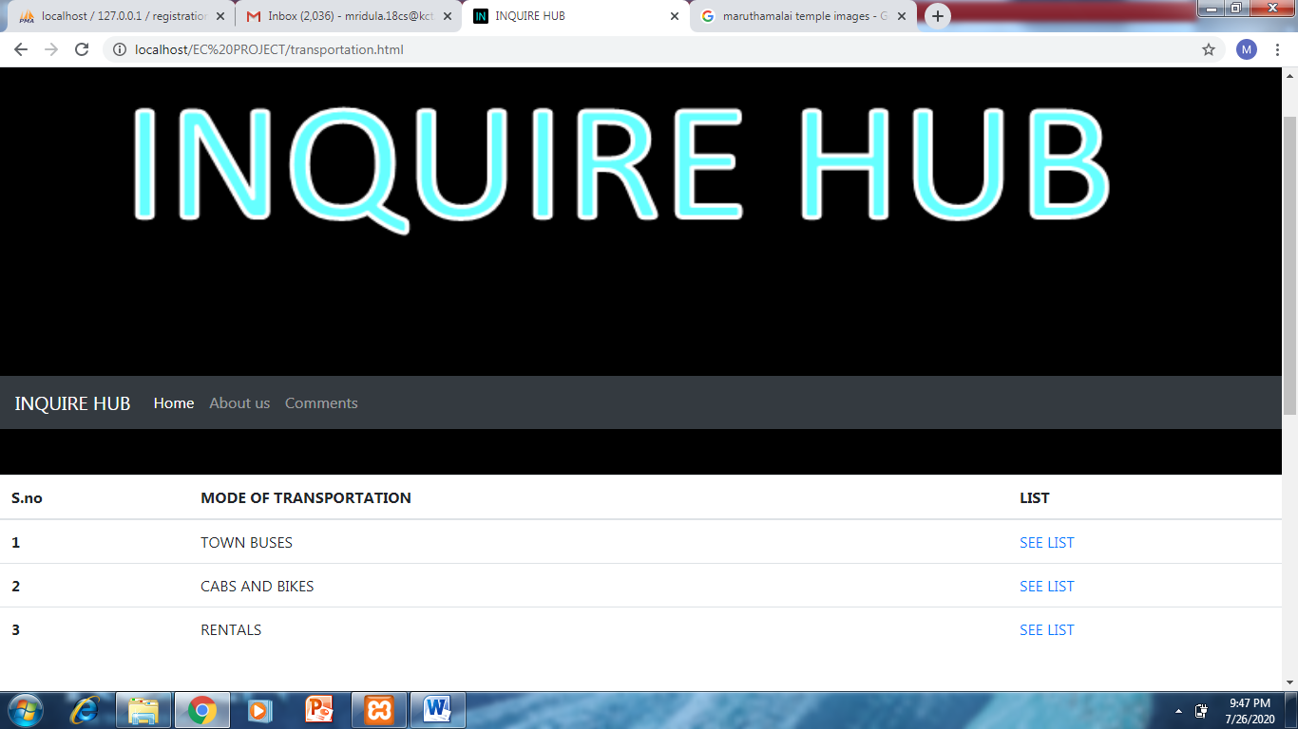
SCREEN SHOTS OF THE WEBSITE
BLOGS PAGE
TRANSPORTATION PAGE

Slide 21
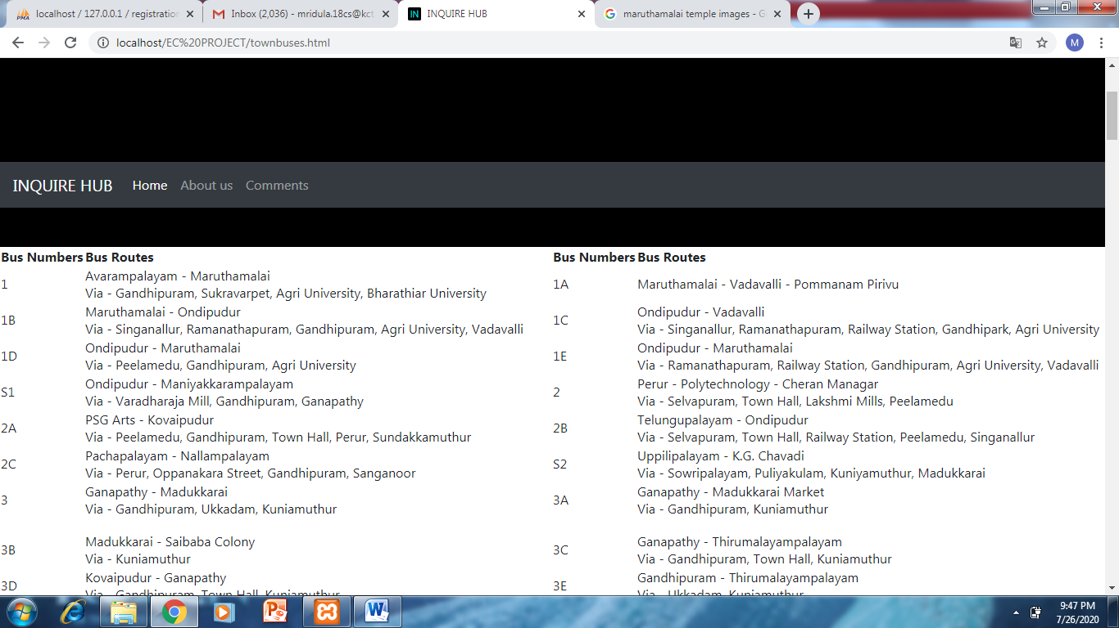
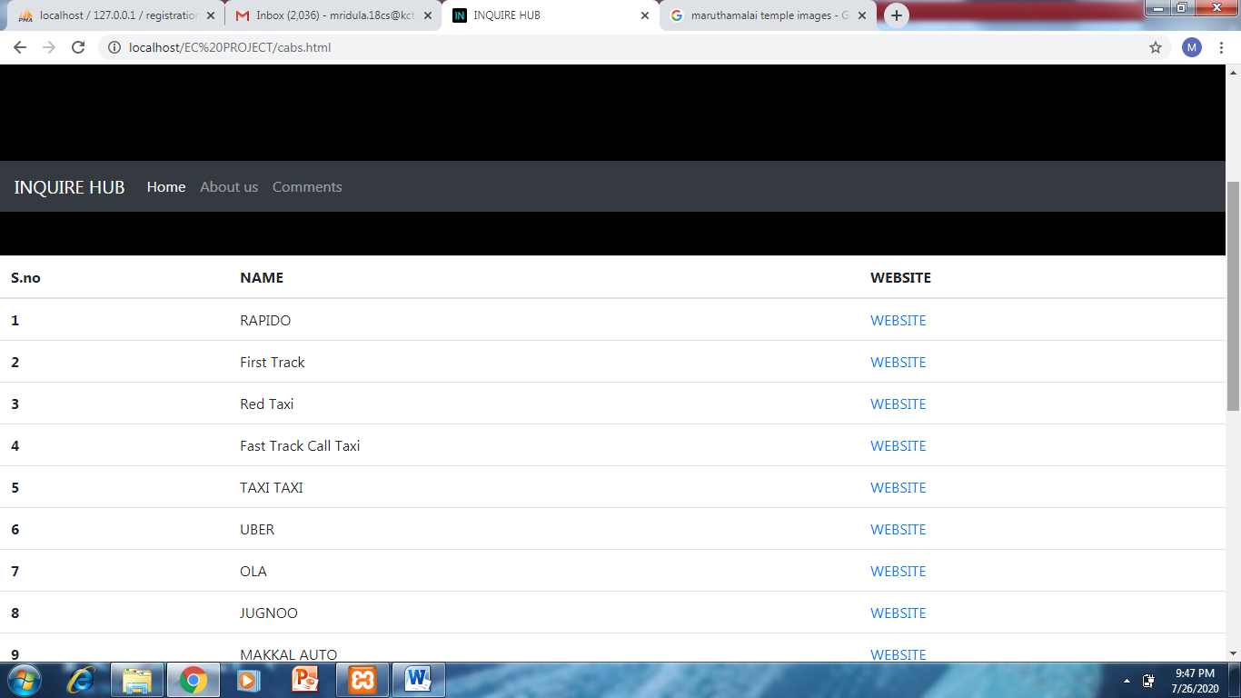
SCREEN SHOTS OF THE WEBSITE
BUSES PAGE
CABS AND BIKES PAGE

Slide 22
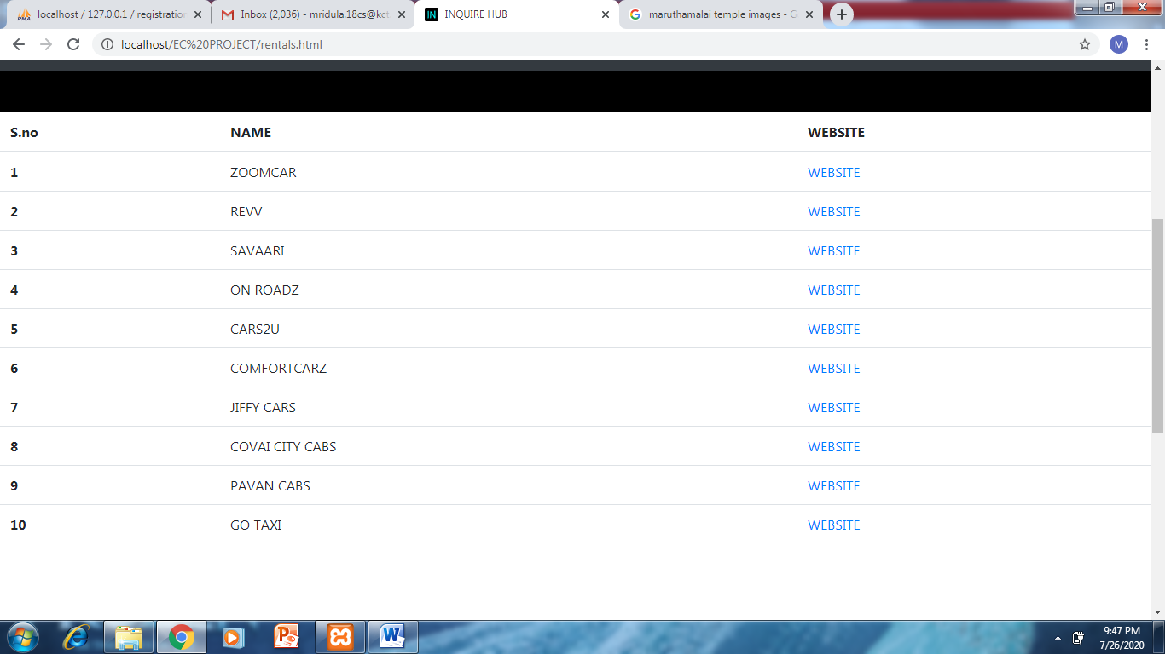
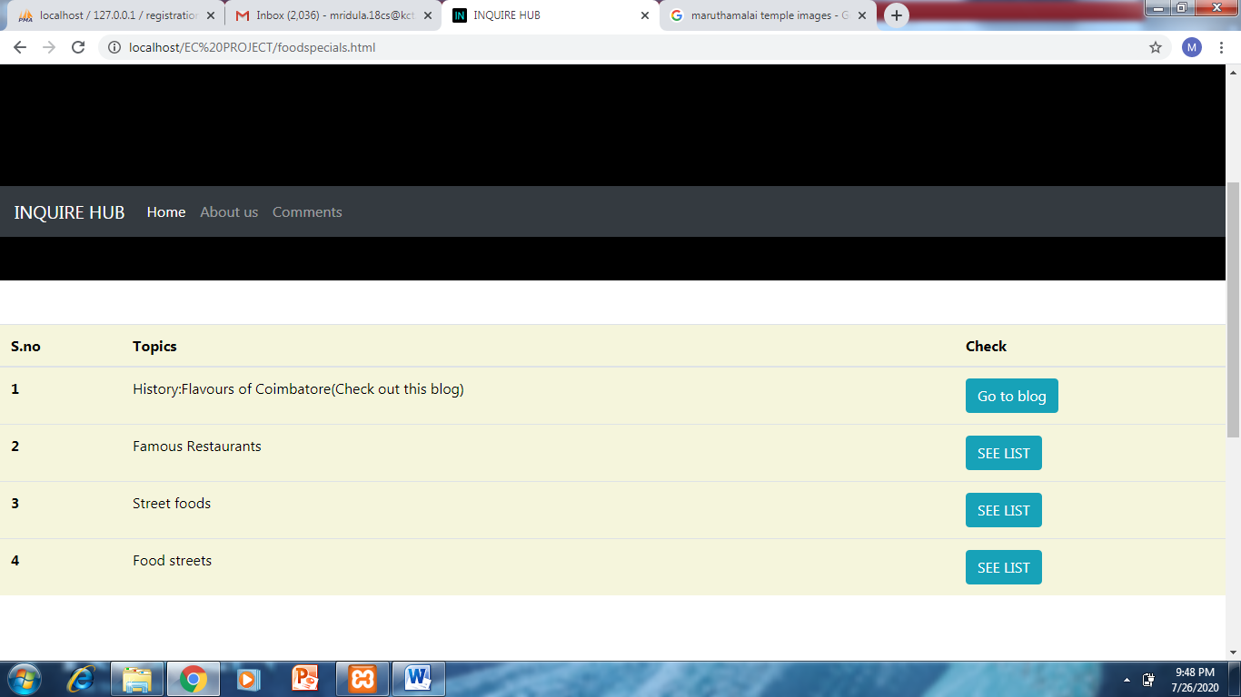
SCREEN SHOTS OF THE WEBSITE
RENTALS PAGE
FOOD SPECIALS PAGE

Slide 23
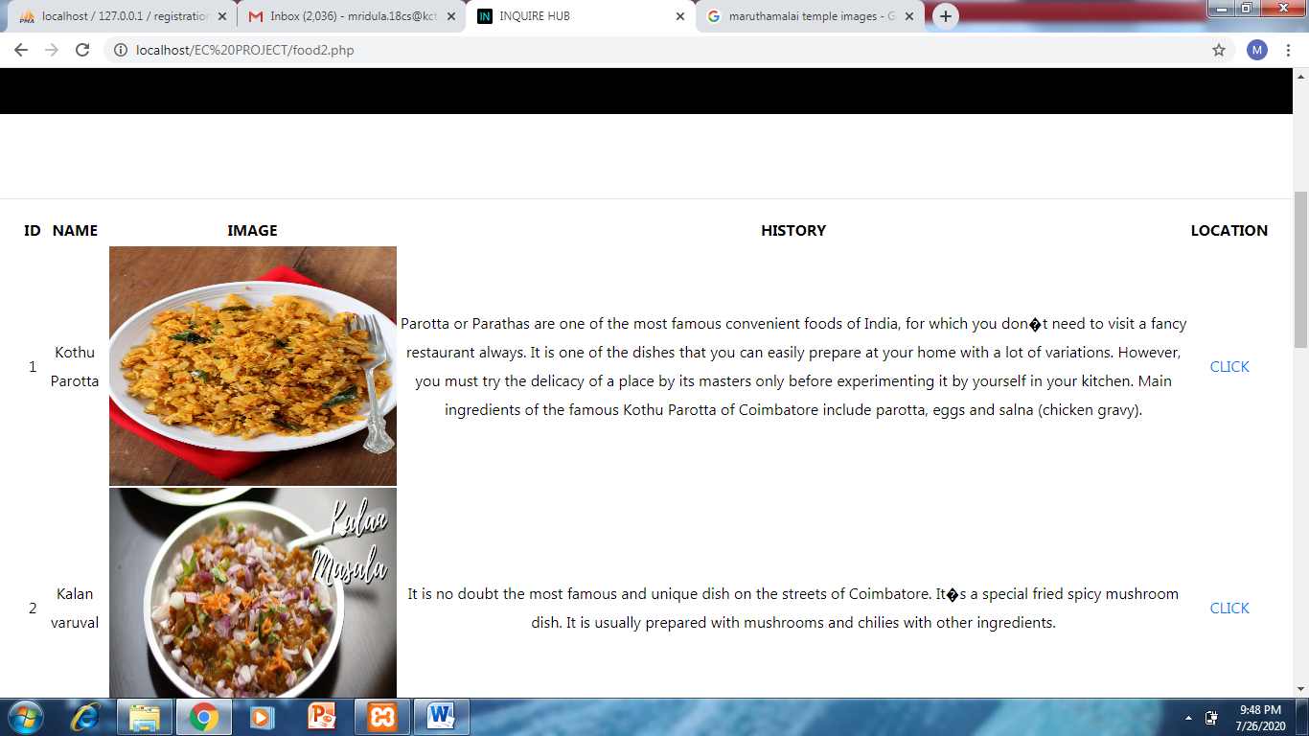
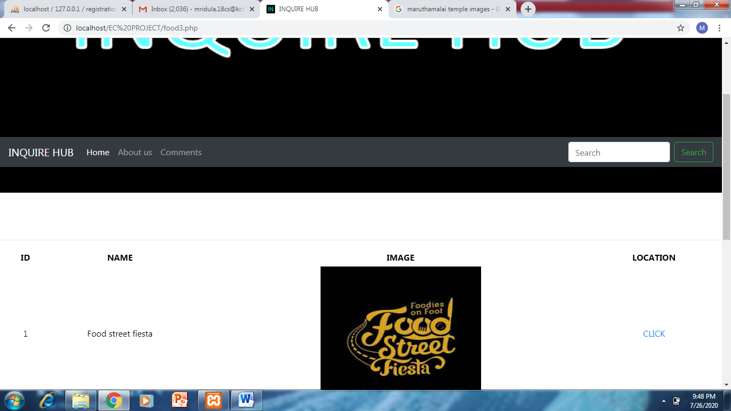
SCREEN SHOTS OF THE WEBSITE
STREET FOODS PAGE
FOOD STREETS PAGE

Slide 24
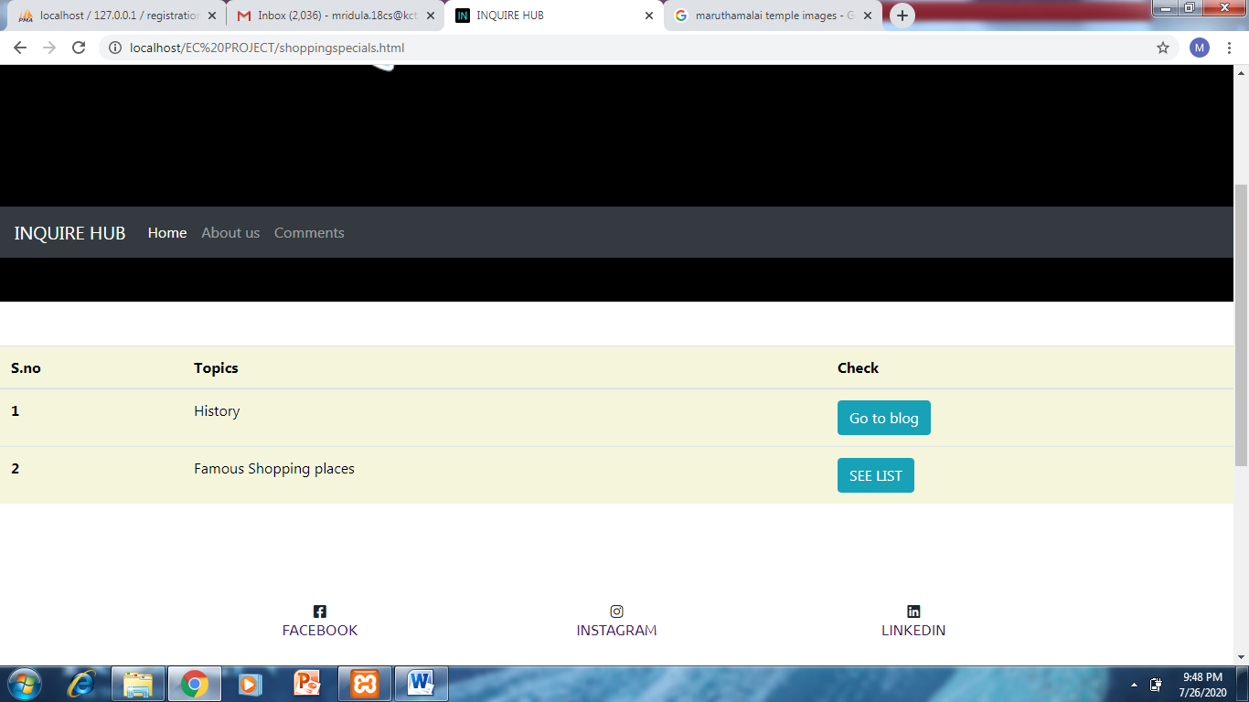
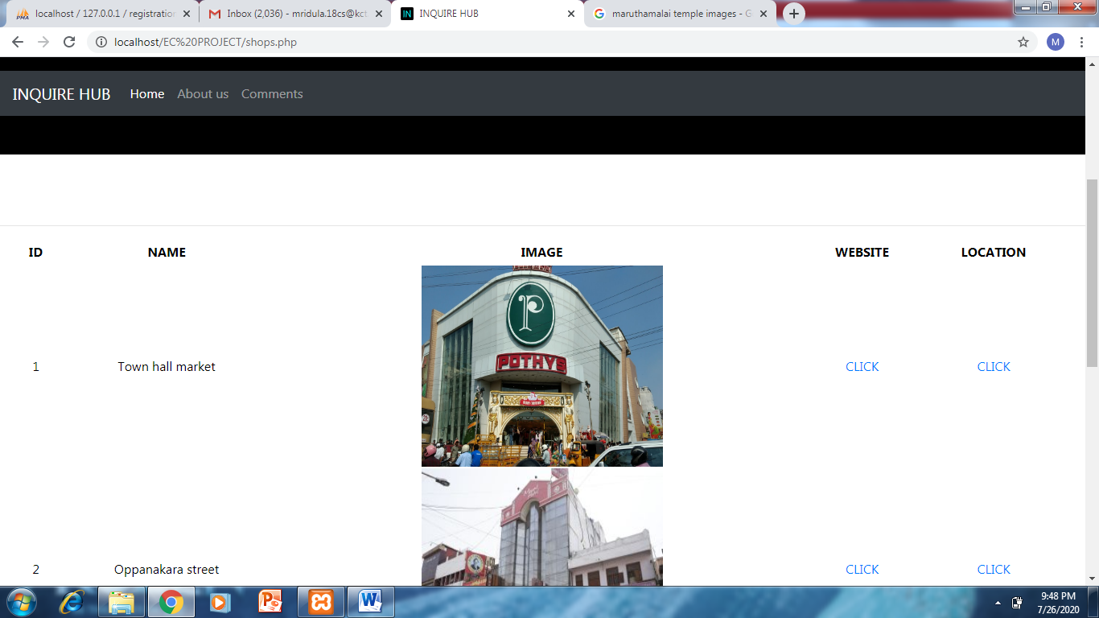
SCREEN SHOTS OF THE WEBSITE
SHOPPING SPECIALS PAGE
FAMOUS SHOPPING PLACES PAGE

Slide 25
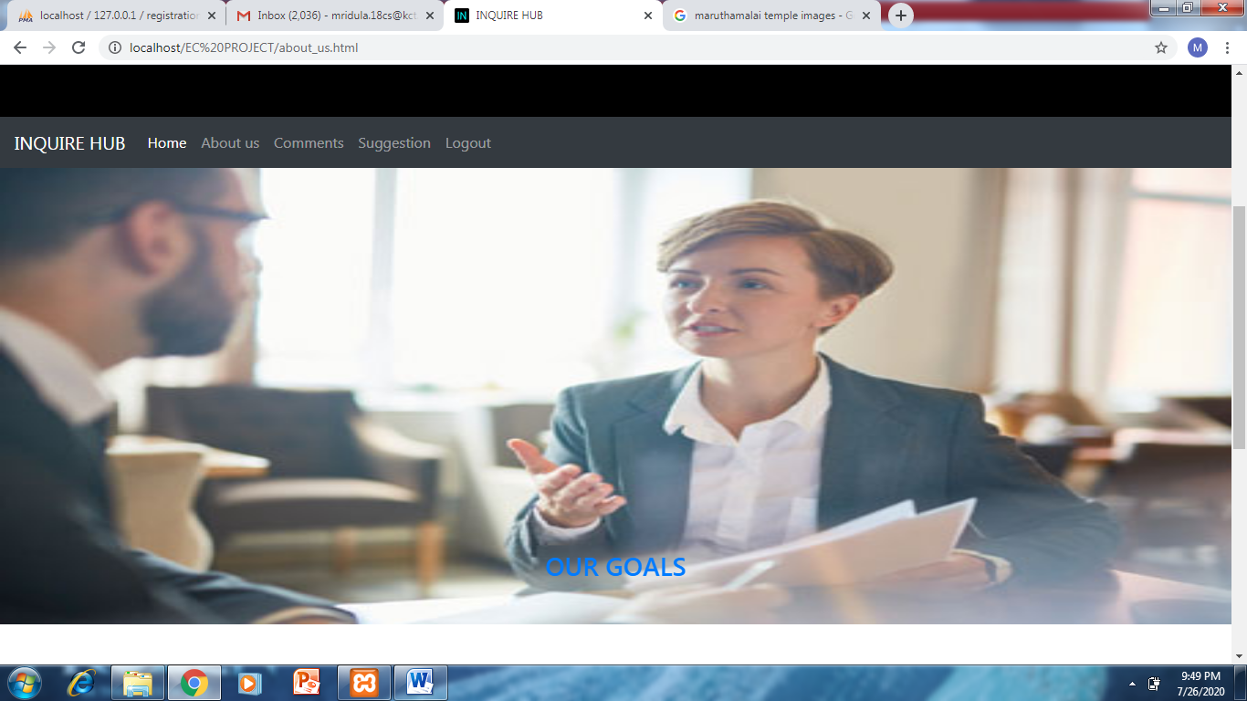
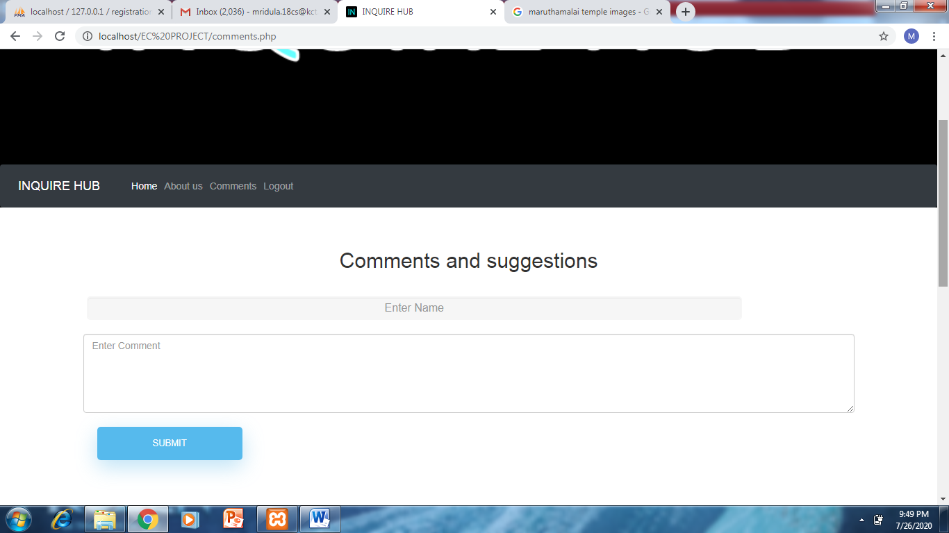
SCREEN SHOTS OF THE WEBSITE
ABOUT US PAGE
COMMENTS PAGE

Slide 26
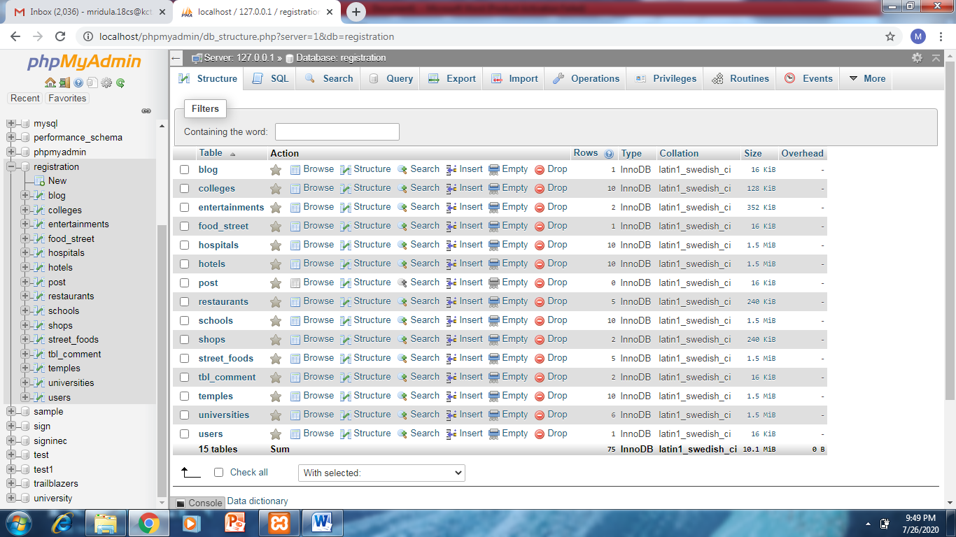
DATABASE AND TABLES

Slide 27
THANK YOU

